Slide 1

INPUT/OUTPUT DEVICES
.

Slide 2
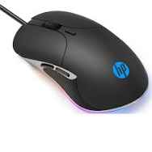
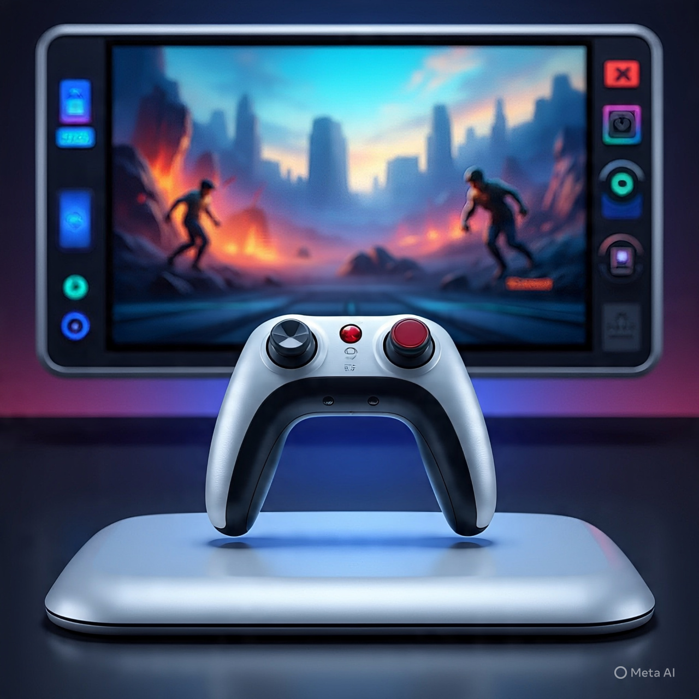

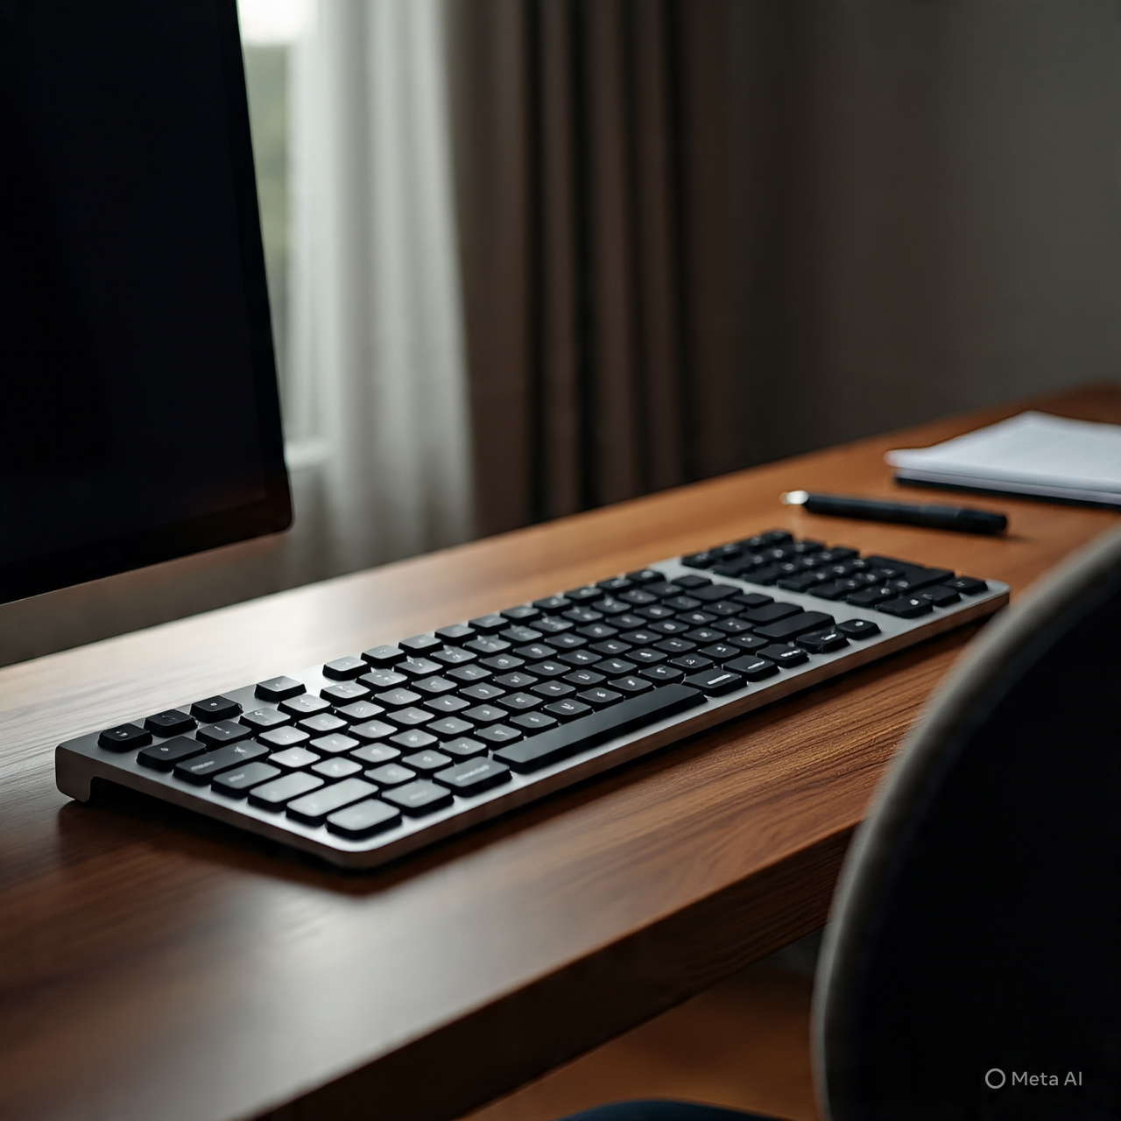
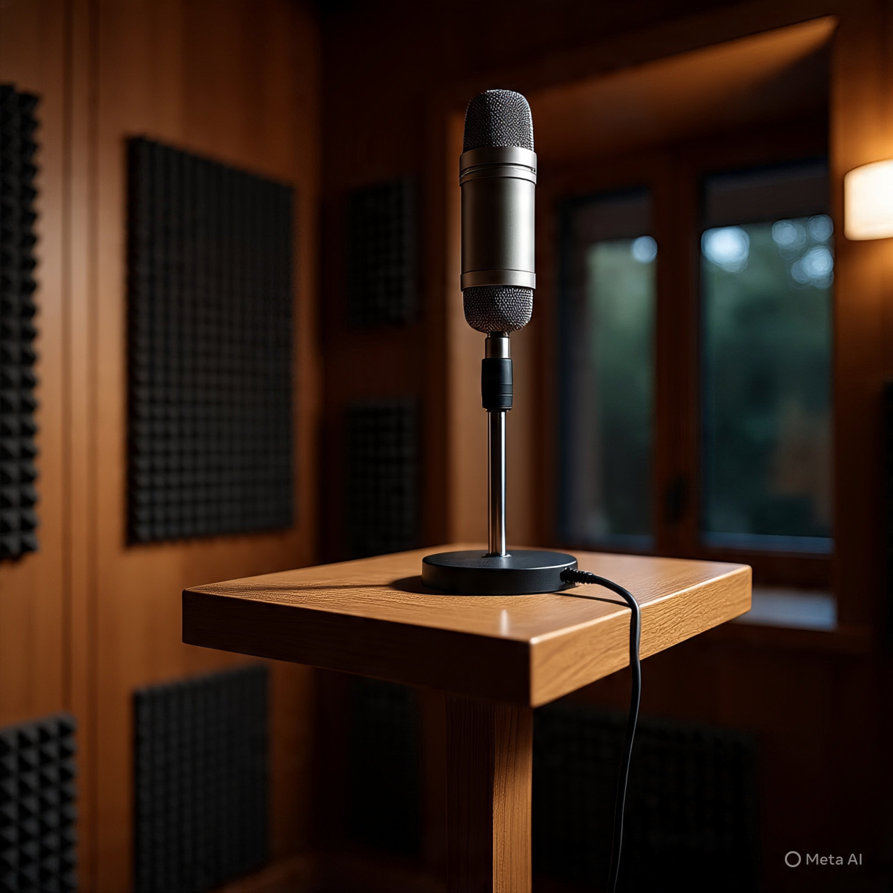
INPUT DEVICES
Input devices are hardware components that allow users to interact with computers, providing data or instruction.

Slide 3
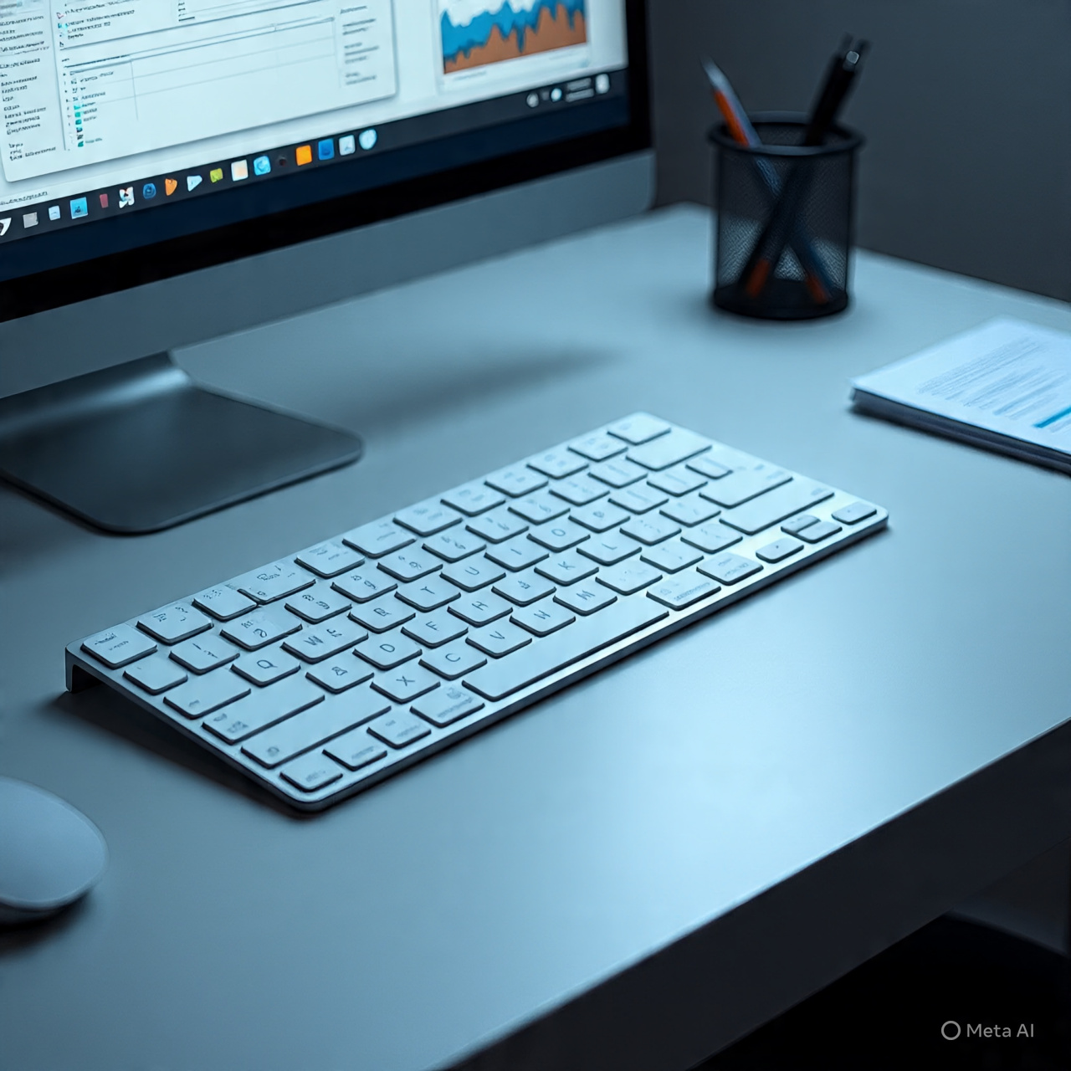
KEYBOARD
Keyboard is an input device that allows users to type text,

Slide 4

MOUSE
A mouse is a computer input device that allows users to interact with graphical user interfaces (GUIs). It's a pointing device that detects movement ad translates it into on-screen cursor movement.

Slide 5
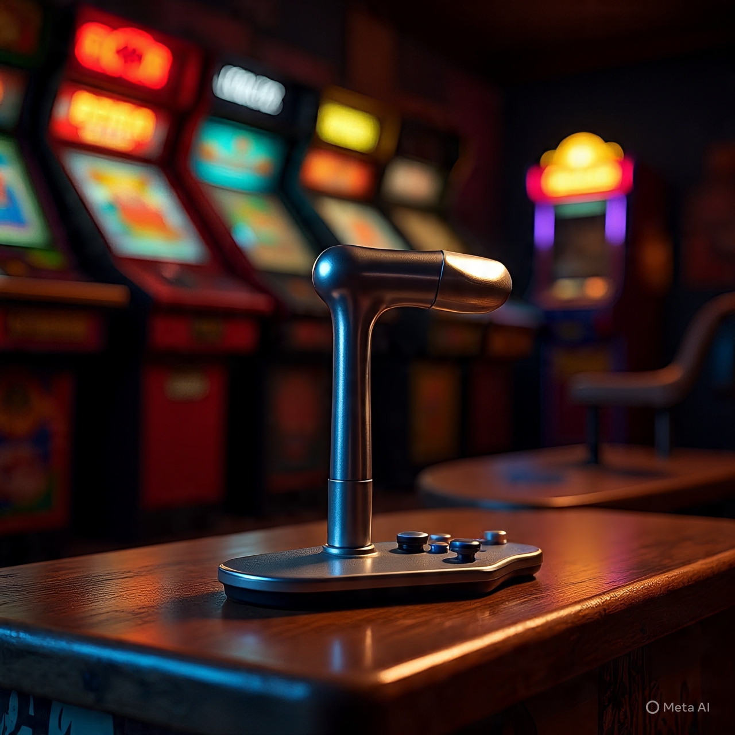
JOYSTICK
A joystick is a control device that allows users to input directional commands or control movements in a device or system.

Slide 6
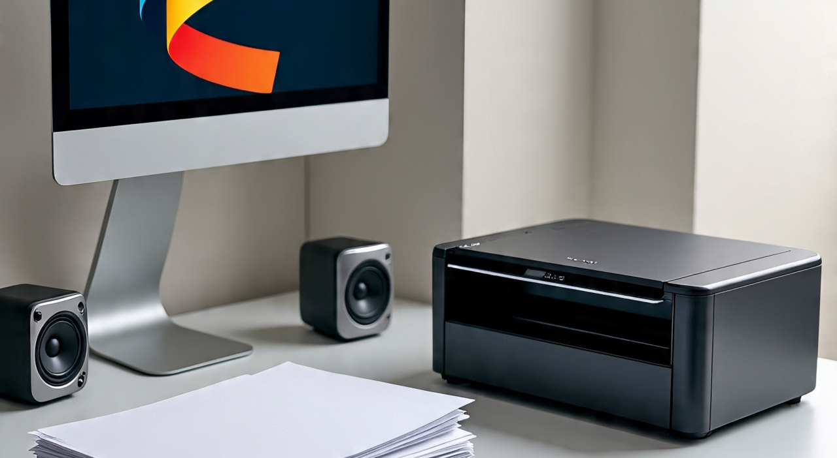
OUTPUT DEVICES

Slide 7
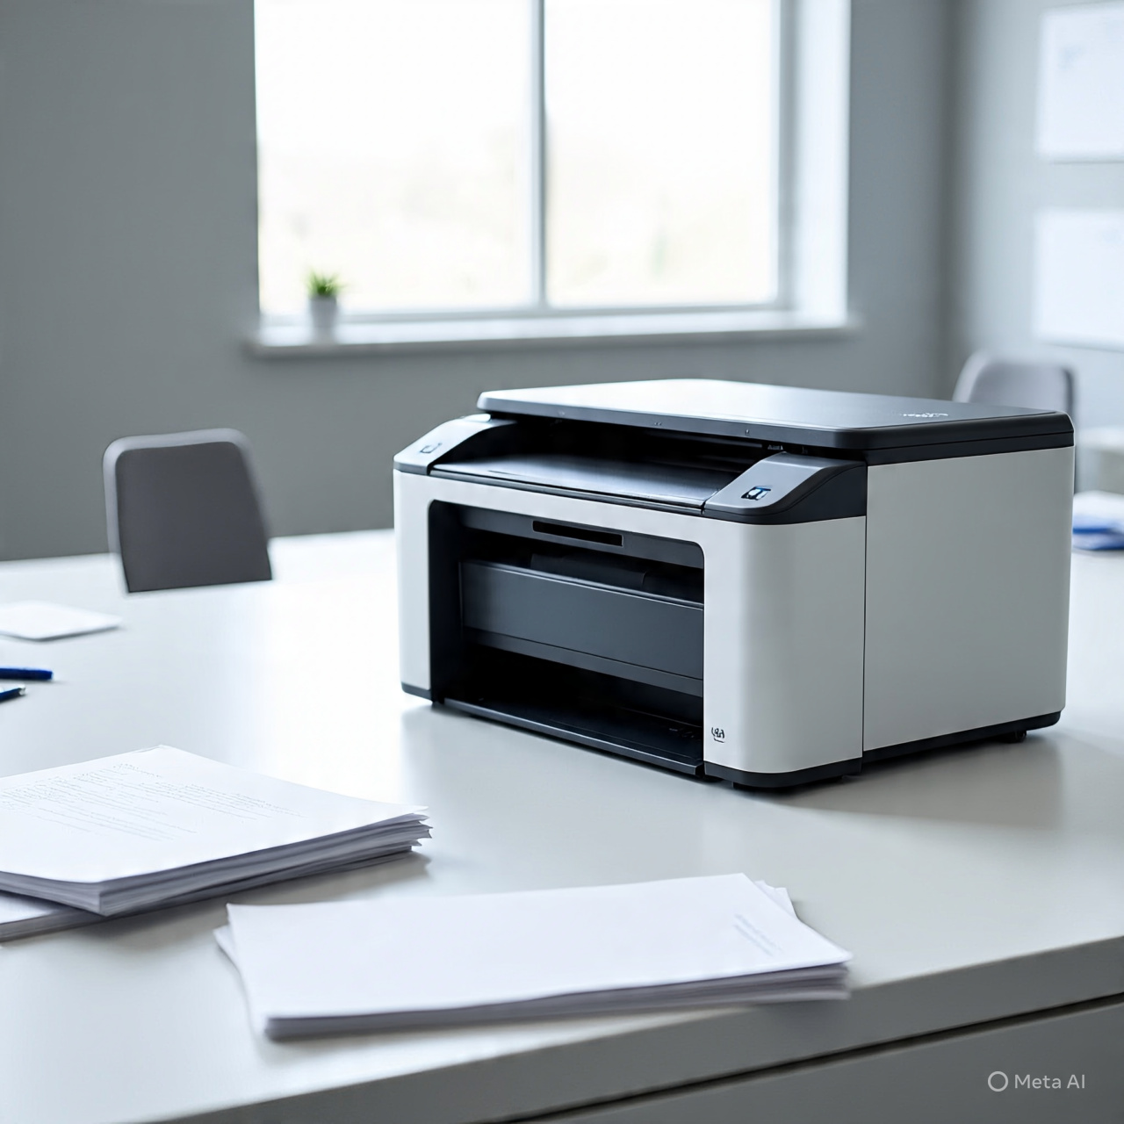
PRINTER
A printer is an output device that produces physical copies of digital documents, images, or other files. It allows users to print text, images, and graphics on paper or other media.

